Slide 2
Annotation of phages and BGCs
Mikael Lenz Strube (milst@dtu.dk)

Slide 3
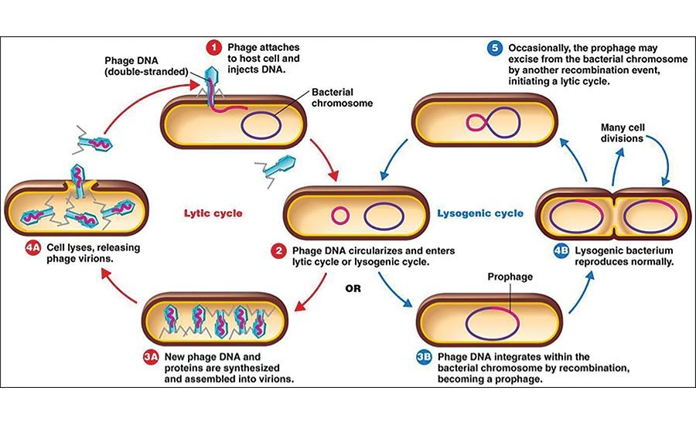
Phages
Viruses that infect bacteria
Will often infect and stay in the genome until better days
this is called a prophage

Slide 4
Phages
Viruses that infect bacteria
Will often infect and stay in the genome until better days
this is called a prophage
Might carry genes that help the bacteria
bacteriocins
antibiotic resistance genes
Can be predicted by
looking for genes that are known phage genes
looking for genes that have different GC%
The first popular one, Phispy, does this:
“PhiSpy was developed based on seven distinctive characteristics of prophages, i.e. protein length, transcription strand directionality, customized AT and GC skew, the abundance of unique phage words, phage insertion points and the similarity of phage proteins.”
Your will work with the command line version of geNomad. An online alternative is PHASTER (https://phaster.ca/)

Slide 5

Biosynthetic gene clusters
Clusters of genes that make genes for production of secondary metabolites
A supreme research interest in biotech
For us: antibiotics, medicine and colorants
For them: molecules they use for communication, nutrient acquisition, competition & etc
Important classes are
Polyketides --- like the antibiotic erythromycin
Non-ribosomal peptides --- like the antibiotic vancomycin
Ribosomal peptides --- like sublancin, carried on a phage infecting Bacillus
These gene complexes can be predicted bioinformatically due to their systematic nature
In CeMiSt we spent ~10 mio € on investigating why bacteria make these compounds
And now an additional 8 mio € to work out what they do to them

Slide 6
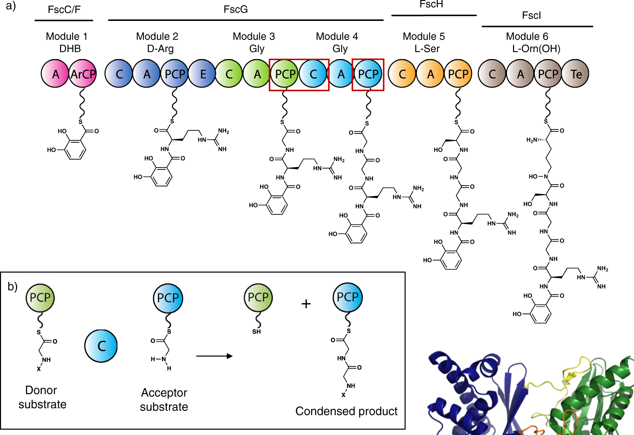
NRPS

Slide 7
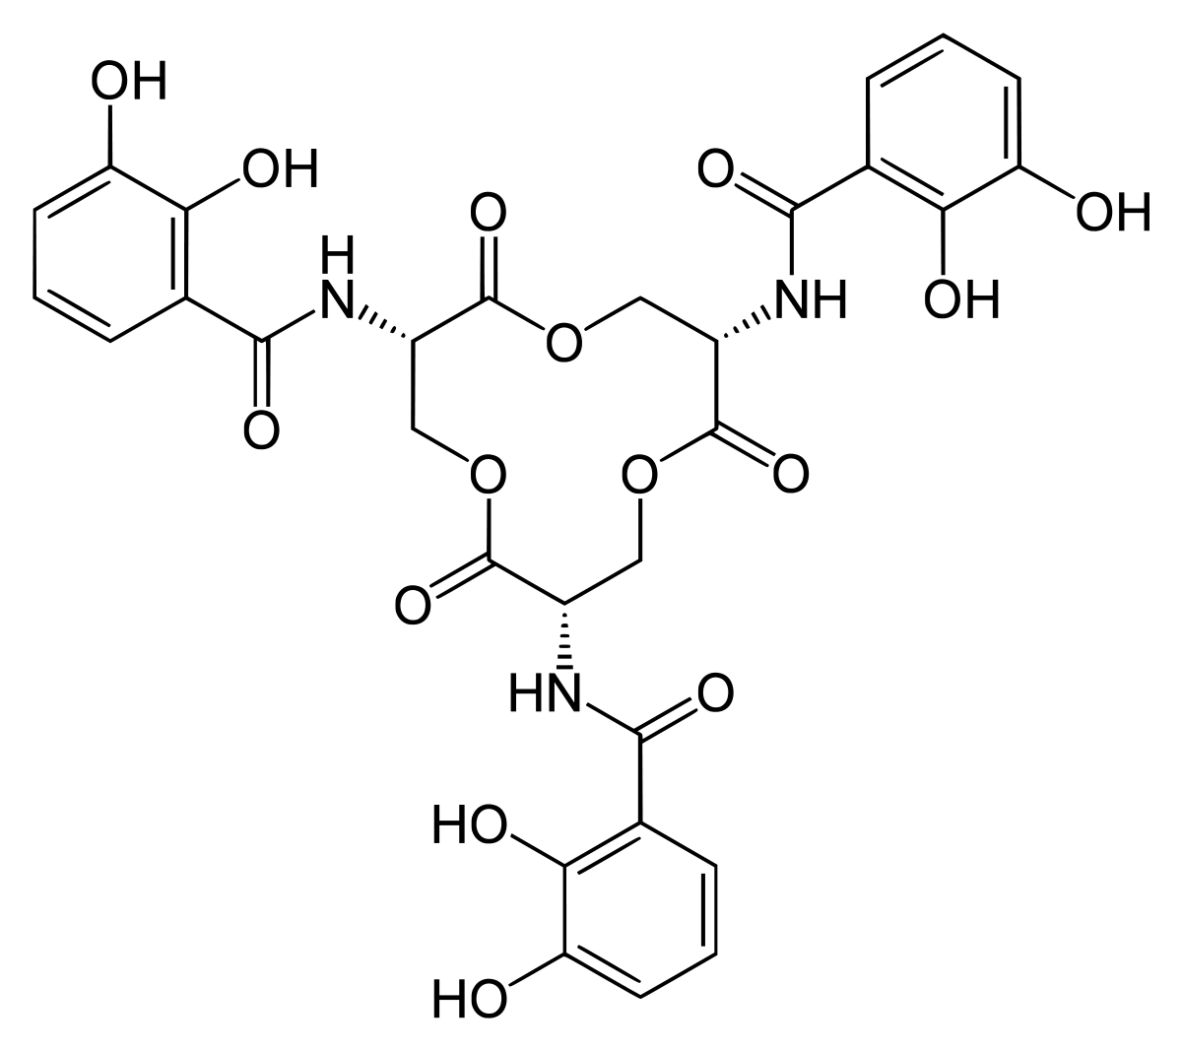
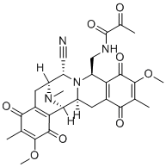
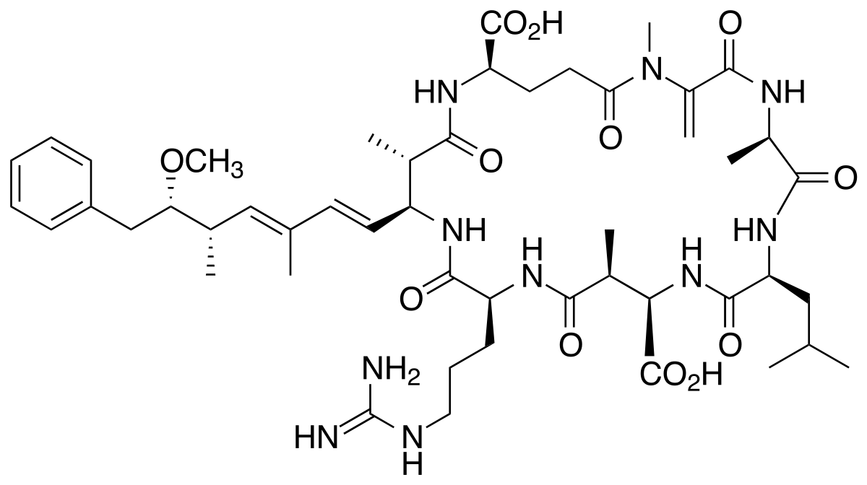
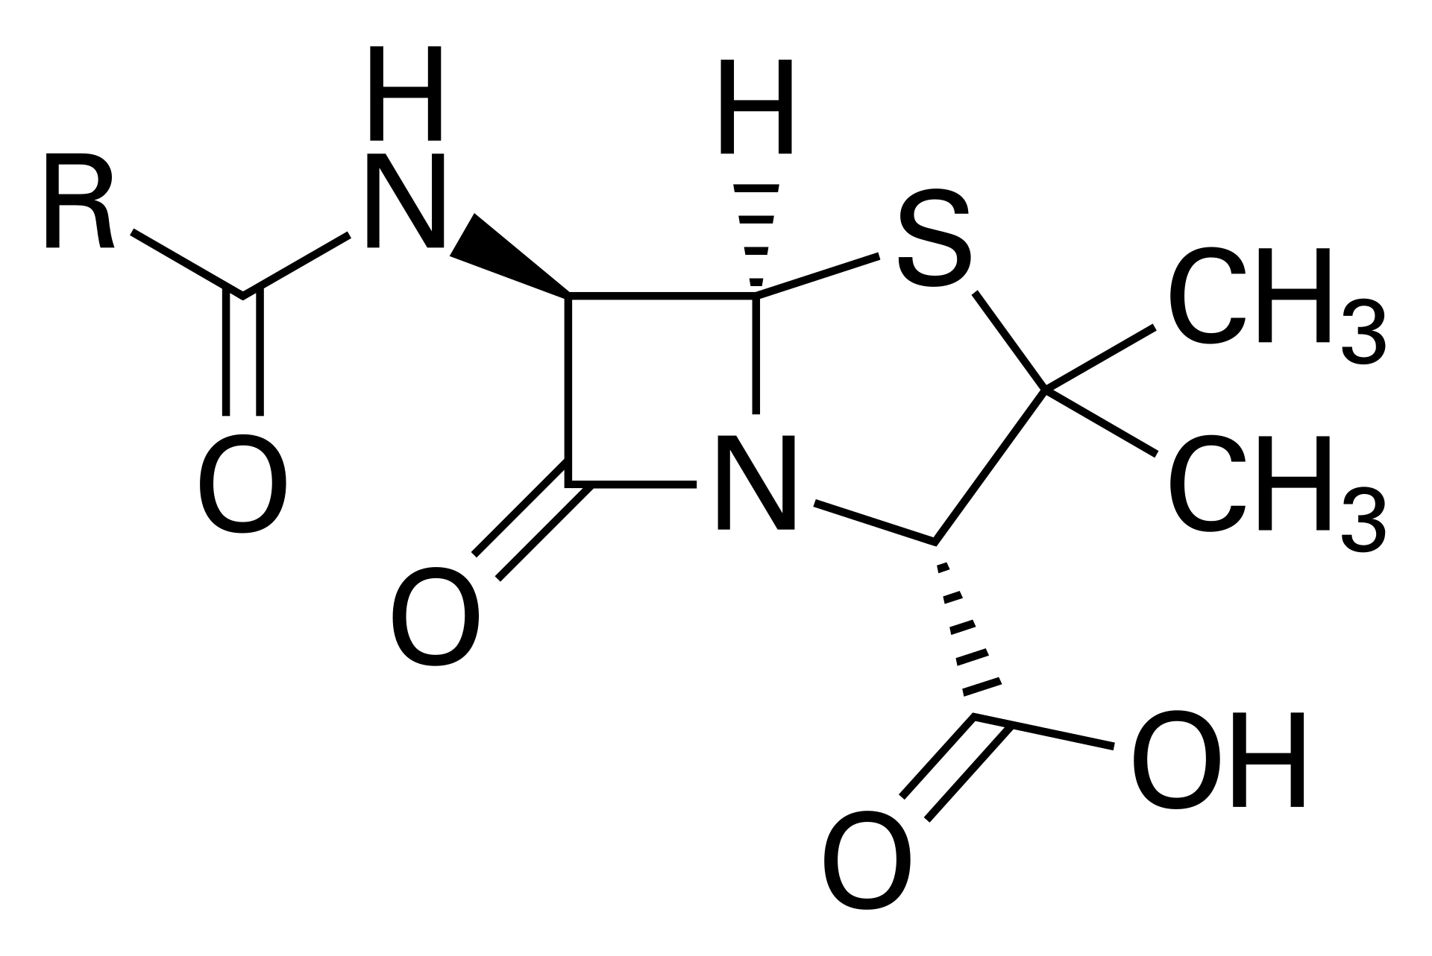
NRPS – Diverse Megasynthases
Notes:
Enterobactin, microcystin, penicillin, saframycin

Slide 8
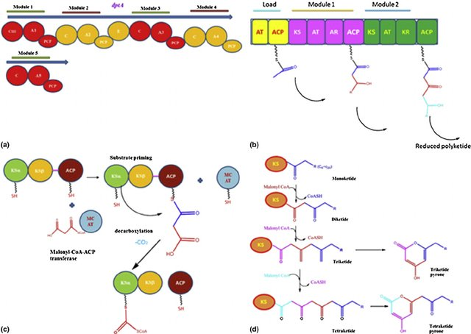
PKS

Slide 9
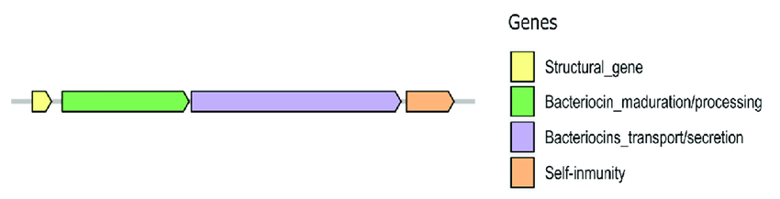
Bacteriocins

Slide 10
AntiSMASH
A well developed software for detecting BGCs, currently the gold standard
Uses a combination of HMMs for detecting key genes and then several rules for picking out BGCs
Is an C-domain followed by a A-domain and then a PCP?
May miss and/or overestimate BGCs
Does not work well on fragmented genomes
Has a nice web server
https://antismash.secondarymetabolites.org/#!/start
You will work with the command line version

Slide 11
Prophage and BGC annotation
Exercise 4
Find prophages with GeNomad
Exercise 5
Find BGCs with antiSMASH
After lunch, we will do phylogenetic analysis and you will need the results from here to make a pretty tree

